Slide 1

Predicting the trends of Azithromycin consumption for the treatment of infectious diseases in the USA by 2025. Group-1 Daniel Asefa Pranavi Shakkari Rahul Chowdary Byrapuneni Sai Sravanthi Kilari Sravya Devisetty Sri Vani Thanniru

Slide 2

Introduction
Azithromycin is a broad-spectrum antibiotic prescribed for many bacterial infections, majorly in pulmonary conditions, genital, and enteric infections.
Azithromycin resistance is a major concern in the current situation. Because, as mentioned in “rationale for Azithromycin in covid-19”, there is a significant rise in the usage of Azithromycin due to post and present COVID-19 complications such as respiratory distress, throat infections.
Past studies like “Mass distribution of Azithromycin for trachoma” have shown that excessive usage of Azithromycin causes resistance for specific bacteria like Escherichia coli, streptococcus pneumonia and many other gram negative bacteria that cause several infections .
The present scenario is exhibiting mass usage of Azithromycin that may repeat similar situation. So, we analyse and interpret the data to predict the future Azithromycin resistance and consumption.

Slide 3
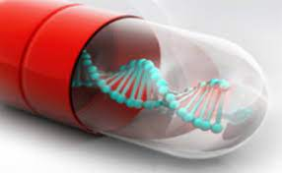
Aim This study aims to determine the various unitigs of the bacterium Neisseria Gonorrhoeae that contribute to increase or decrease the Azithromycin consumption for the treatment of infectious diseases, using various genomic and csv data analysis tools and visualization techniques, and predict the trends of Azithromycin consumption in the USA by 2025.
Purpose
The purpose of the study is to identify, test, and investigate different unitigs of the Bacterium Neisseria Gonorrhoea associated with Azithromycin resistance and predict the increase or decrease in the consumption of Azithromycin to treat bacterial infections by 2025 in the United States.
This study may helps understand about the impact of Azithromycin usage in infectious diseases.

Slide 4
Research Hypothesis
Null Hypothesis: There is no association among the factors tested and cannot predict the consumption of Azithromycin.
Alternate Hypothesis: There is a significant association among the factors tested and can predict the consumption of Azithromycin.

Slide 5

PROCESS OVERVIEW
DATA COLLECTION
Predicting antibiotic resistance in gonorrhea.
https://www.kaggle.com/nwheeler443/gono-unitigs
It is the resistance exhibited by different strains of Neisseria Gonorrhoeae to various antibiotics in different countries from 1979-2015.
DATA CLEANING, EXTRACTION
Finding missing values
Finding Correlation
DATA EXPLORATION
Visualisation of the data
Normality test
METHODOLOGY
Developing a Model
Performance analysis
STATISTICAL TESTING
MANCOVA
RESULTS

Slide 6
DATA COLLECTION AND DESCRIPTION

Slide 7
Metadata:
consists of 3700 rows and 31 columns.
columns related to Azithromycin were retained.
GWAS(Genome Wide Association Studies) Data:
consists of unitigs of Neisseria Gonorrhoeae bacteria:
0 - mutation absent
1 -mutation present
Changed from Rtab to csv file and is uploaded to the jupyter notebook of python

Slide 8
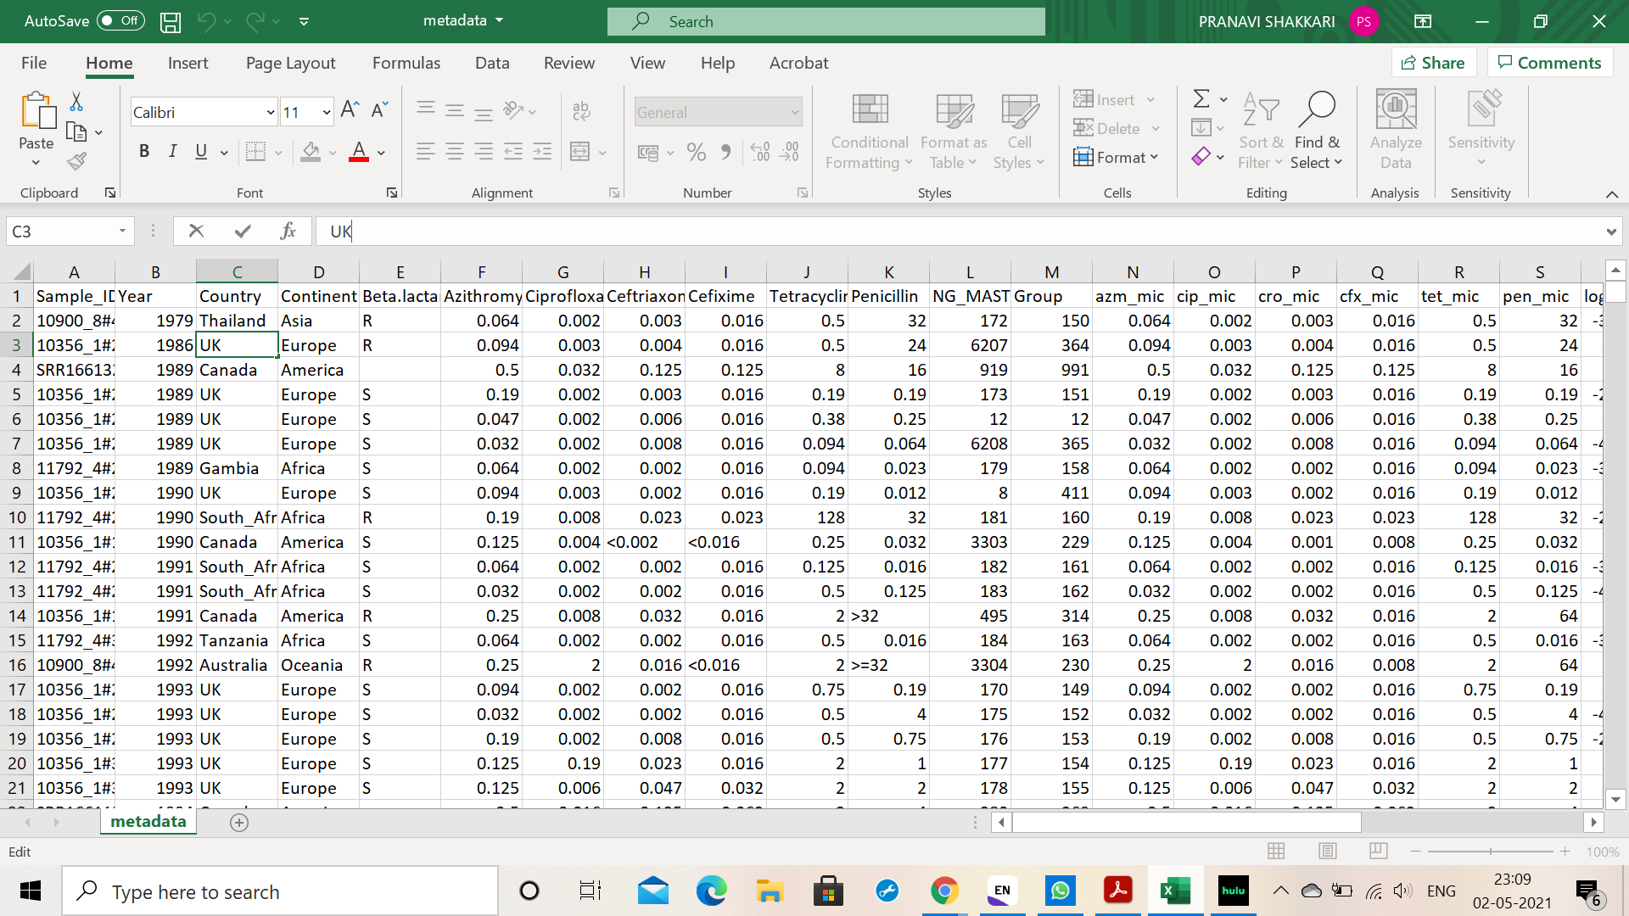
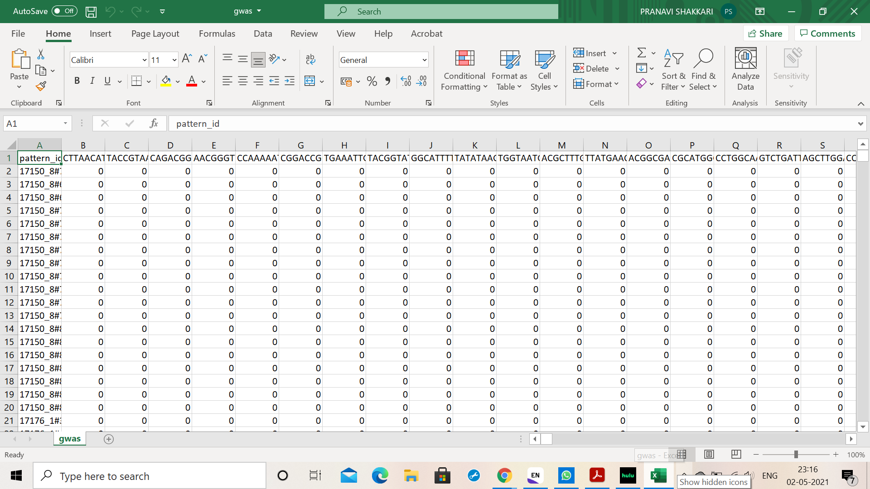
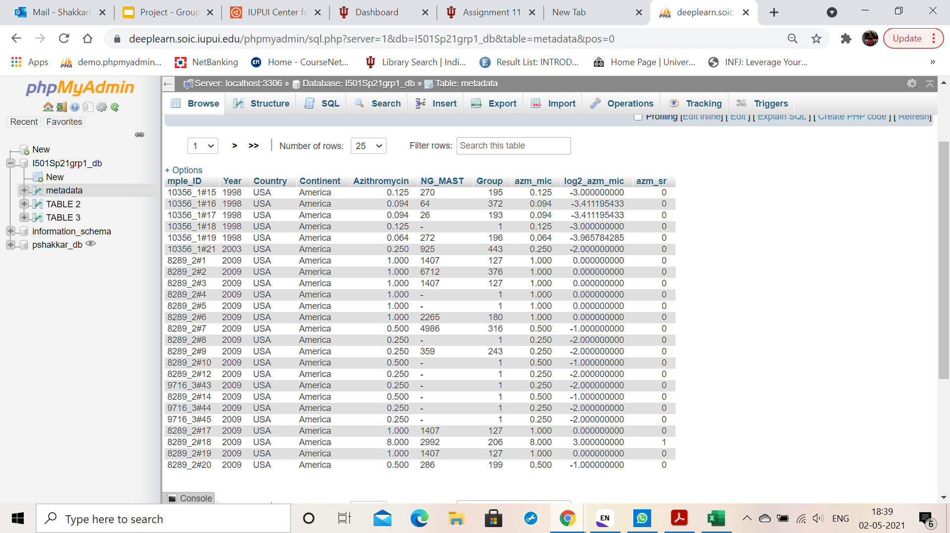
Original metadata
GWAS data
Metadata imported to MYSQL database.

Slide 9
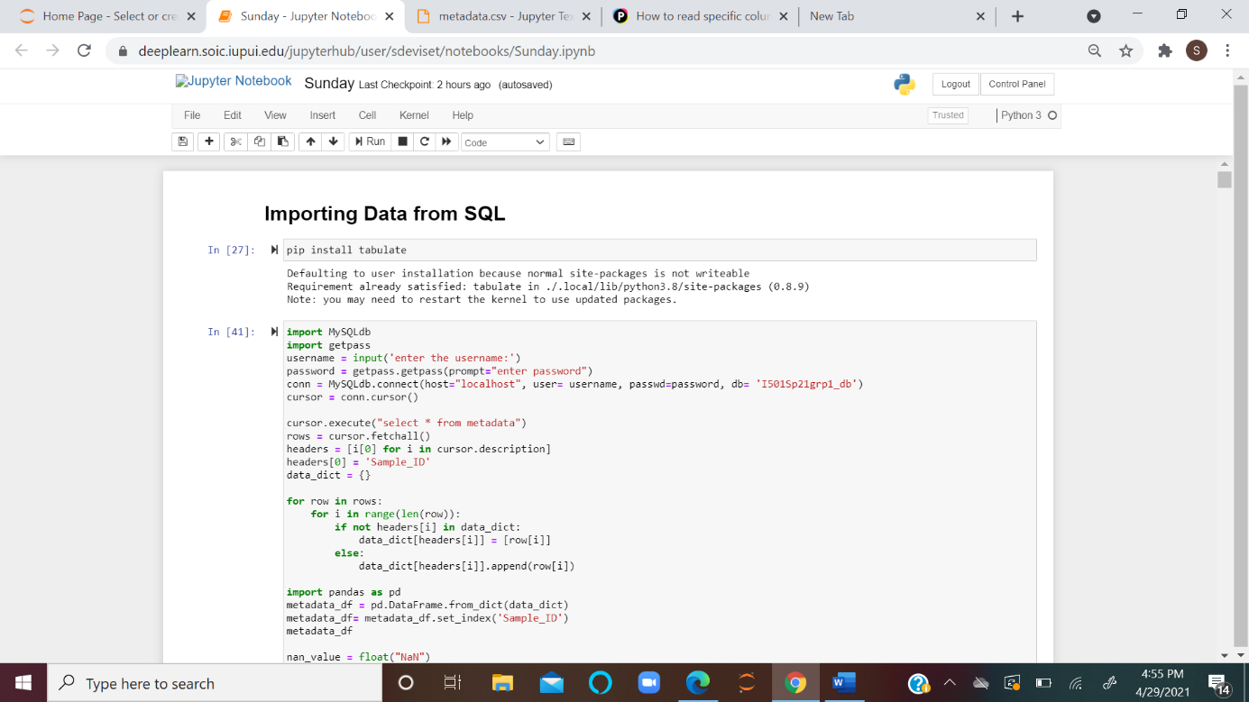
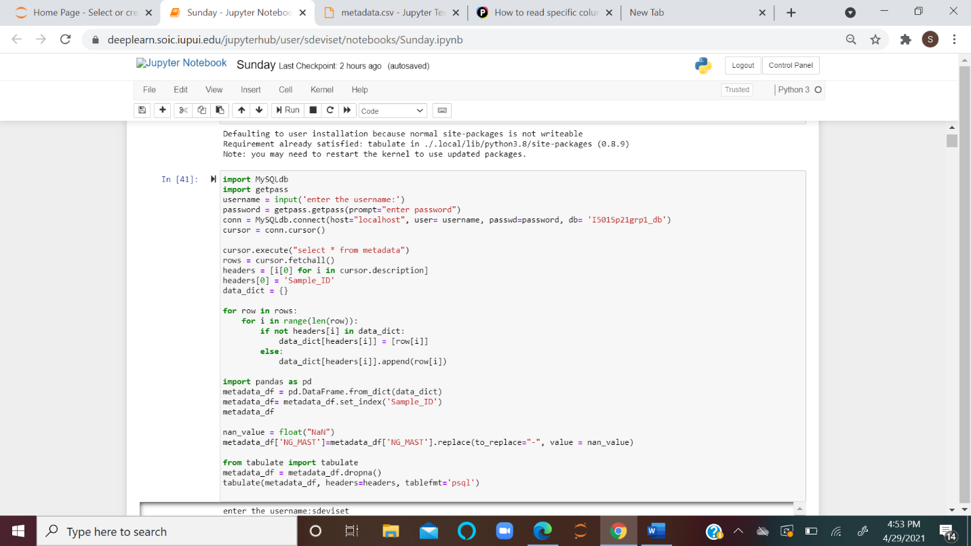
Data Cleaning:

Slide 10
DATA CLEANING AND ENHANCEMENT

Slide 11
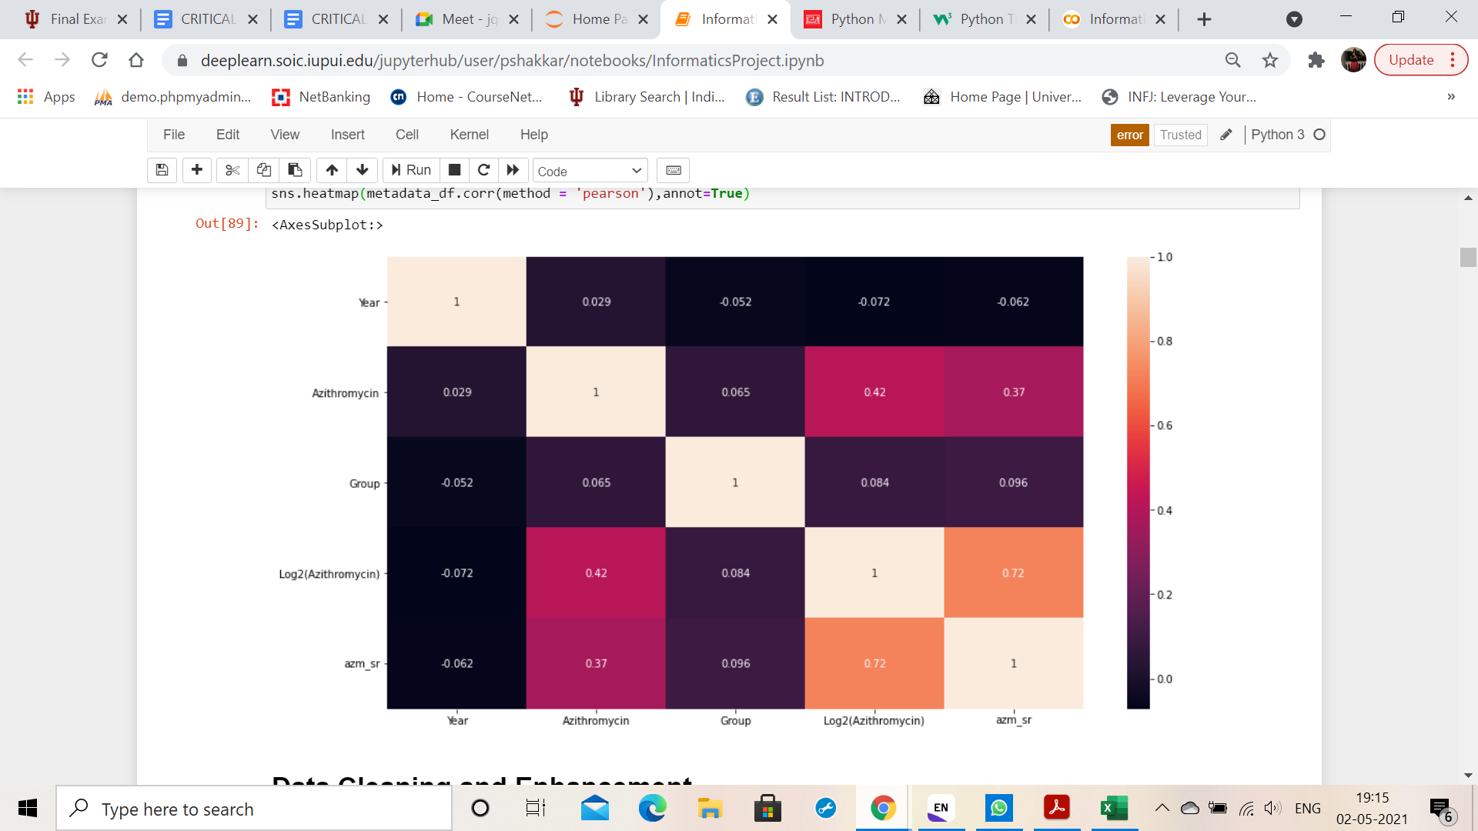
Correlation matrix

Slide 12
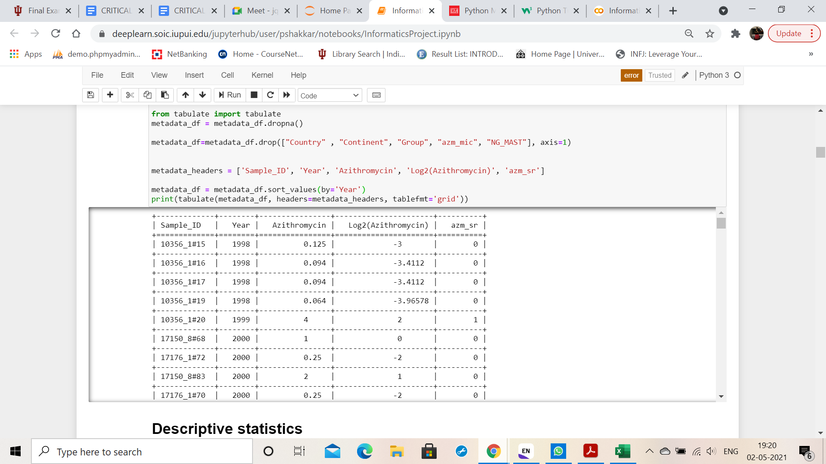
Drop columns Country, Continent since all the values are same.
Drop column azm_mic since it is same as column Azithromycin.

Slide 13
DATA EXPLORATION

Slide 14
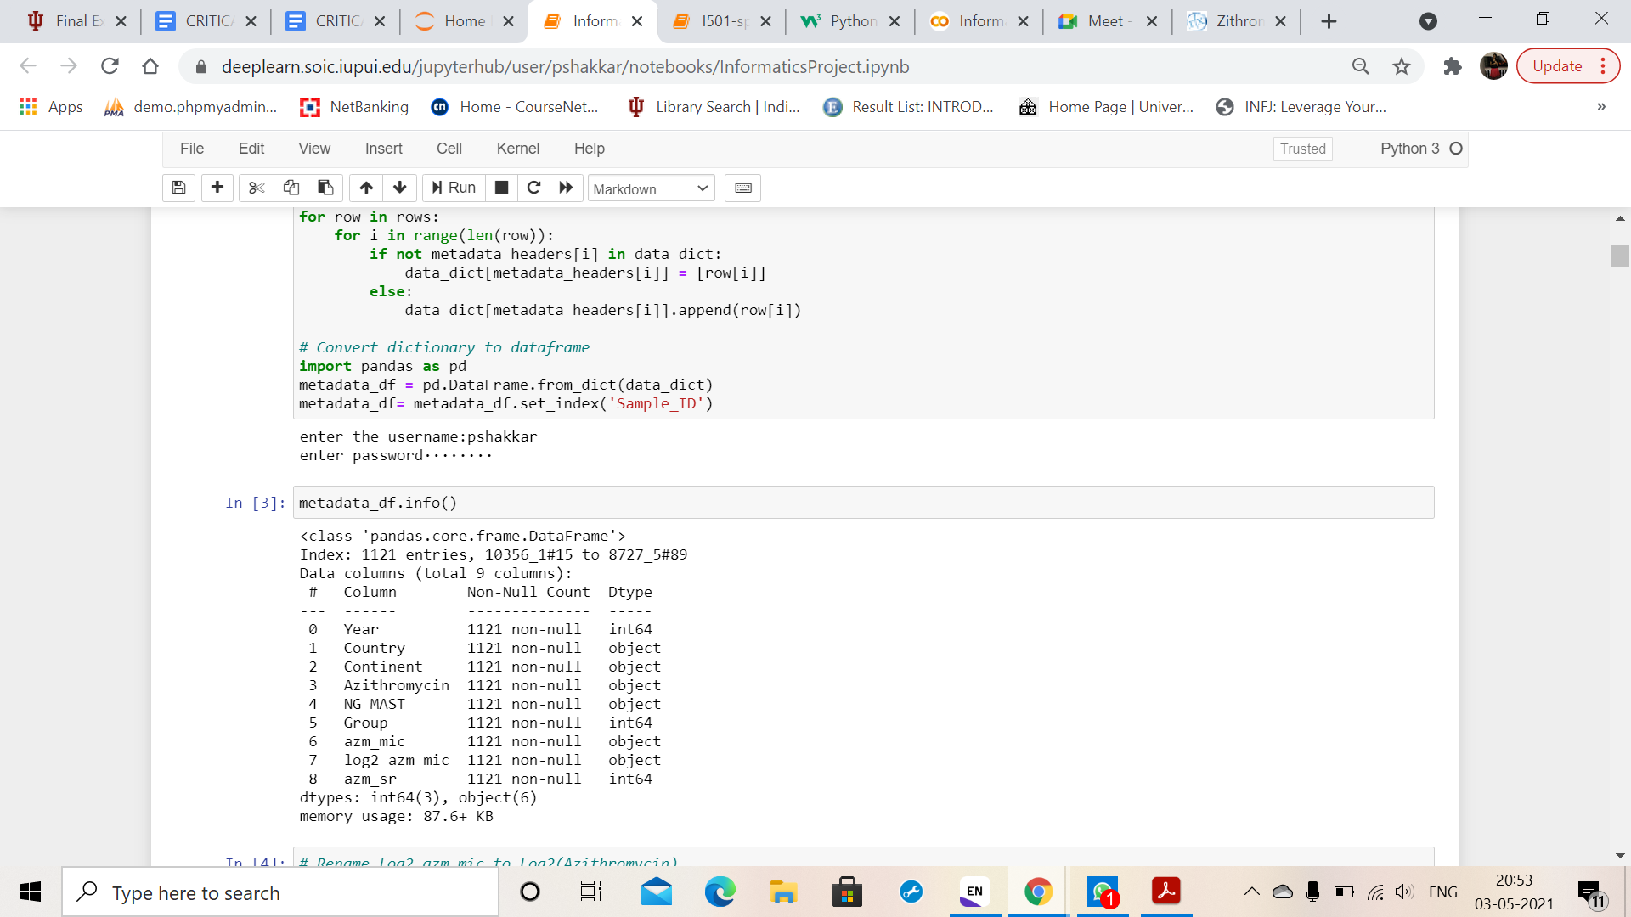
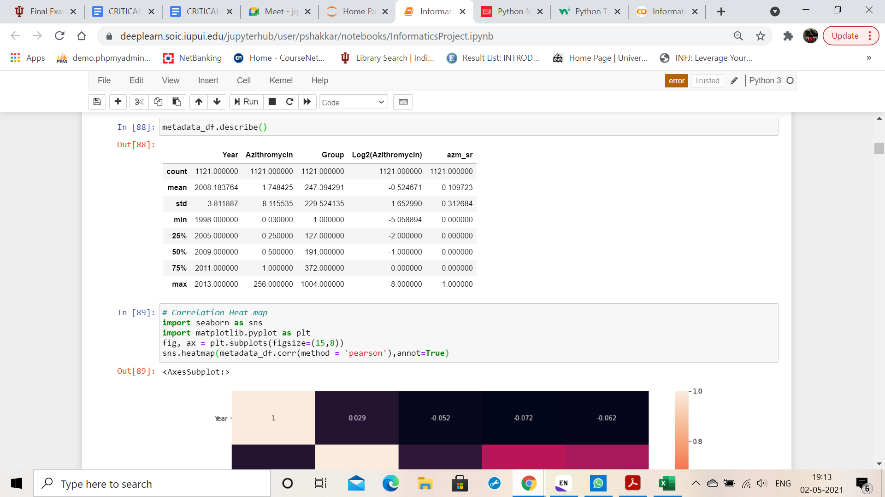
DESCRIPTIVE STATISTICS

Slide 15
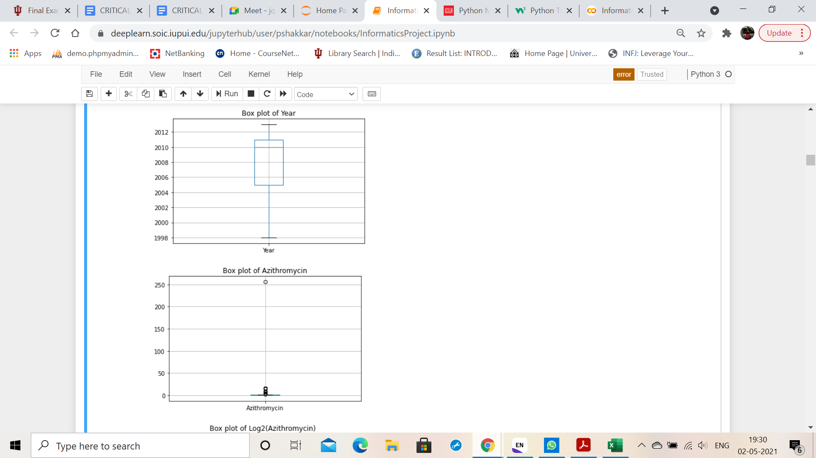
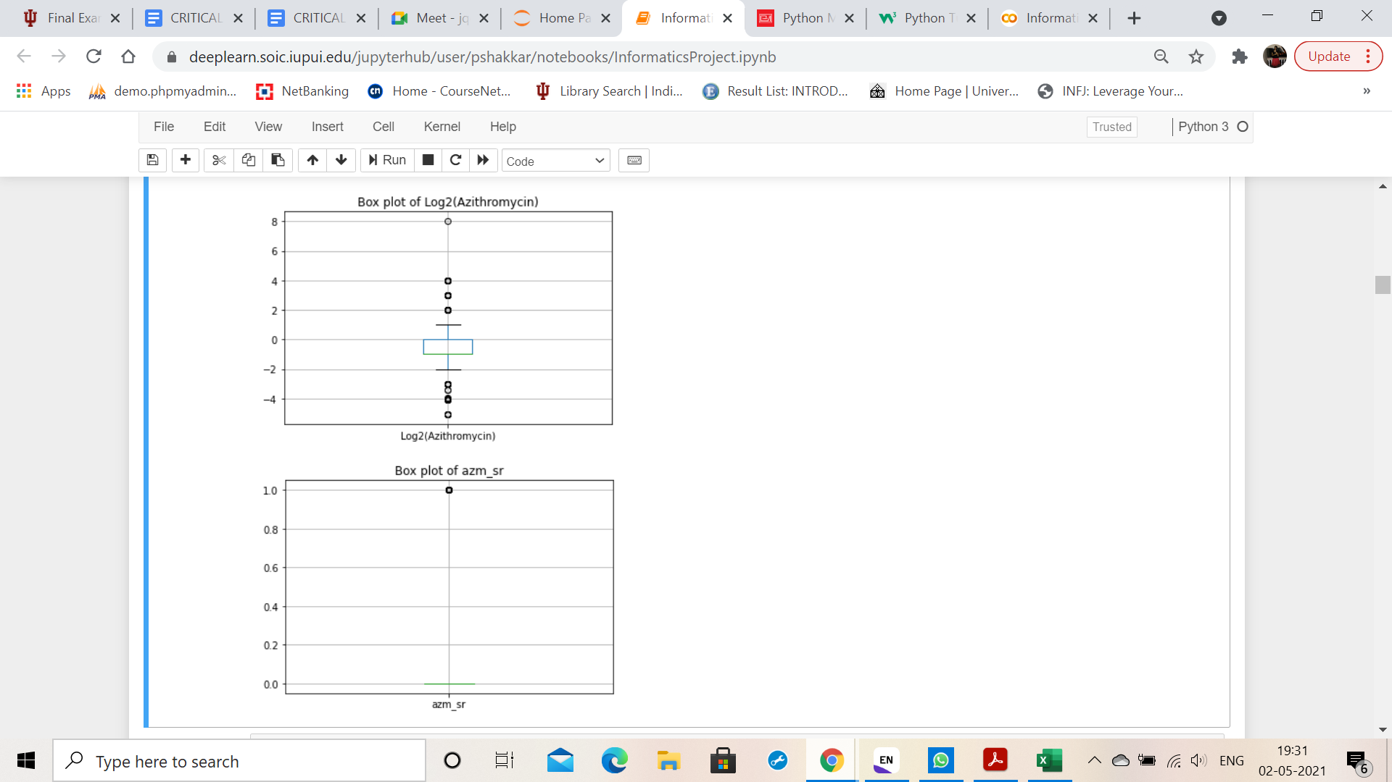
DATA VISUALIZATION OF CLEANED METADATA
An outlier is observed.

Slide 16
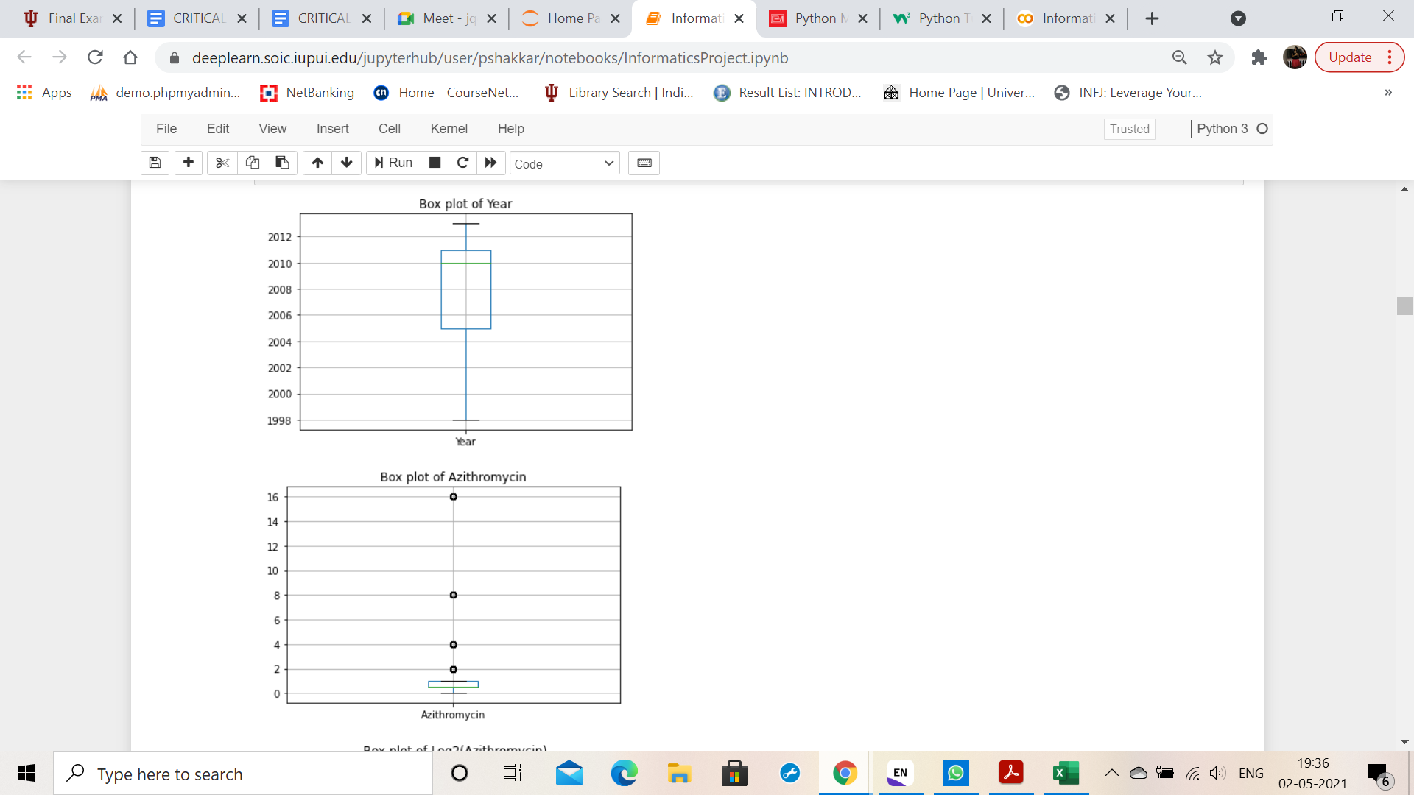
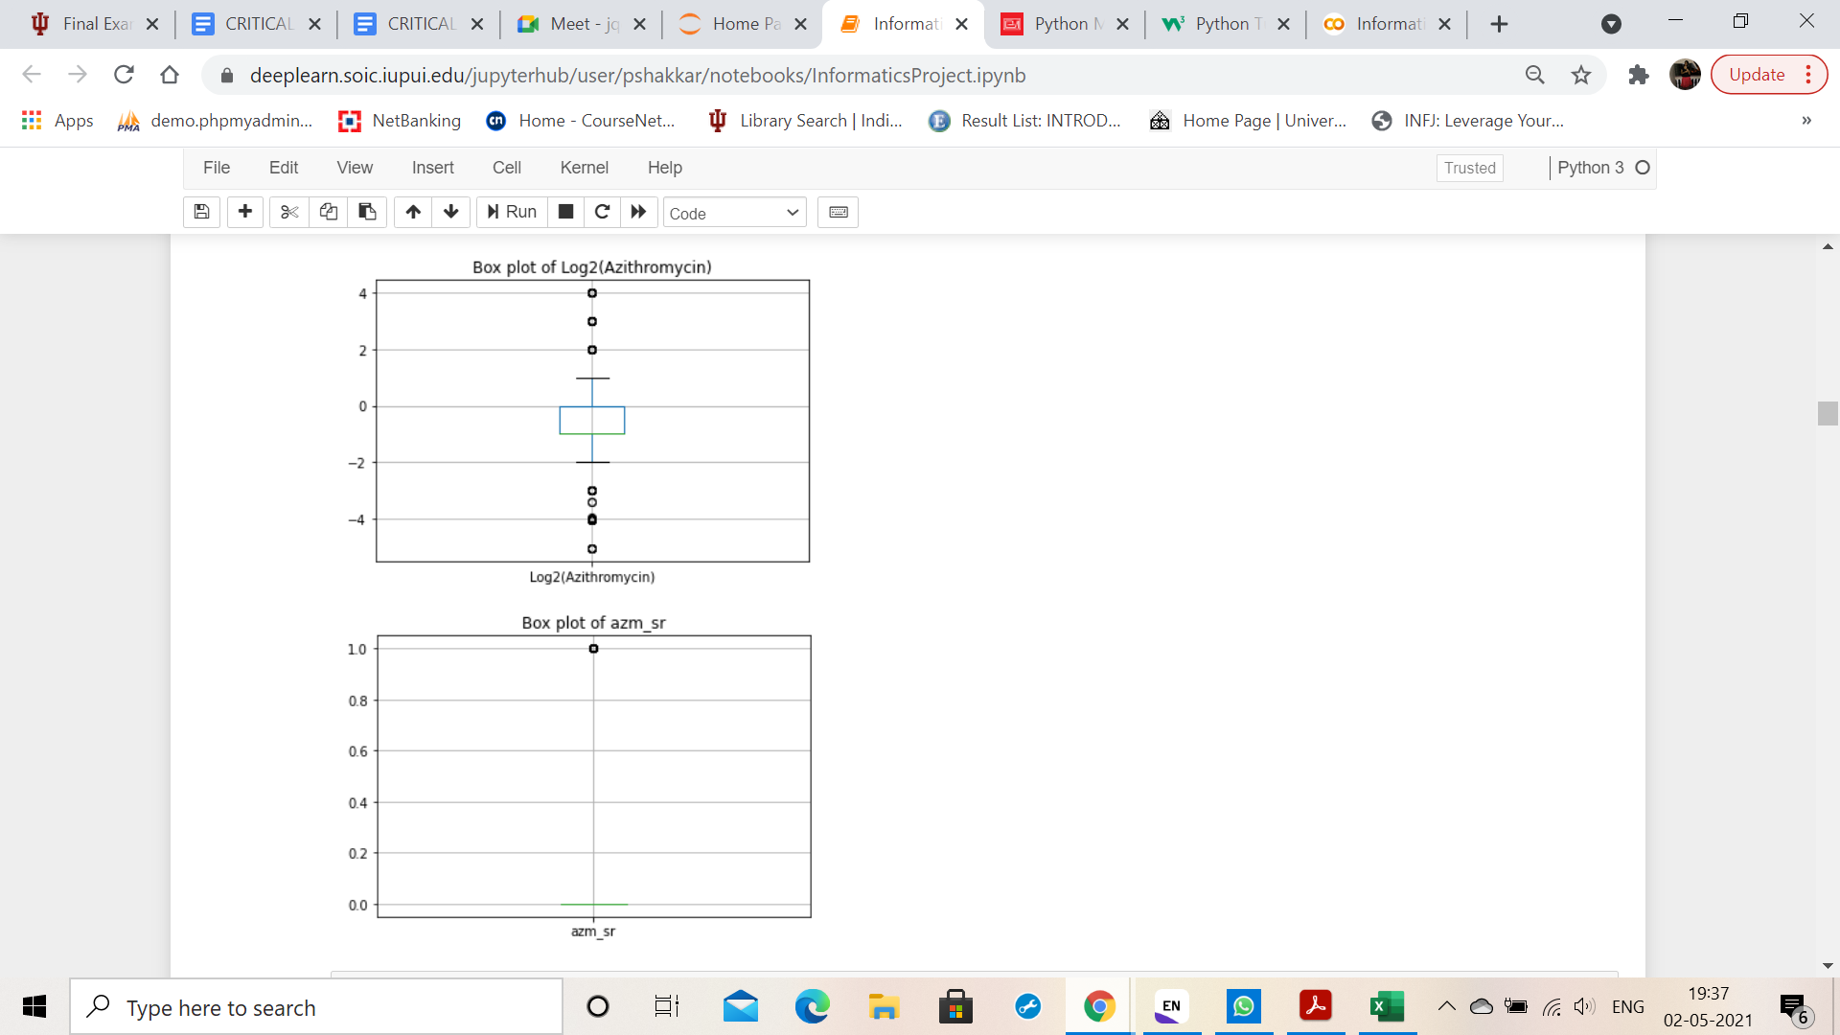
After removal of outlier

Slide 17
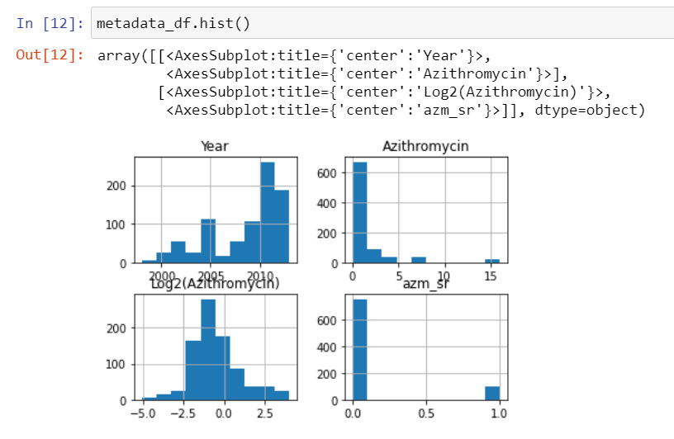

Slide 18
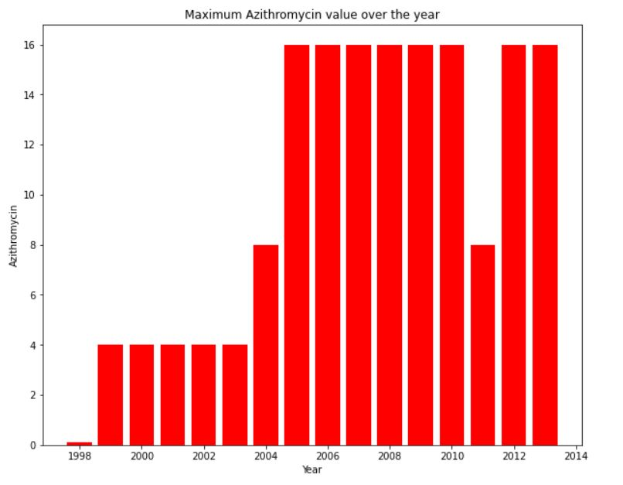

Slide 19
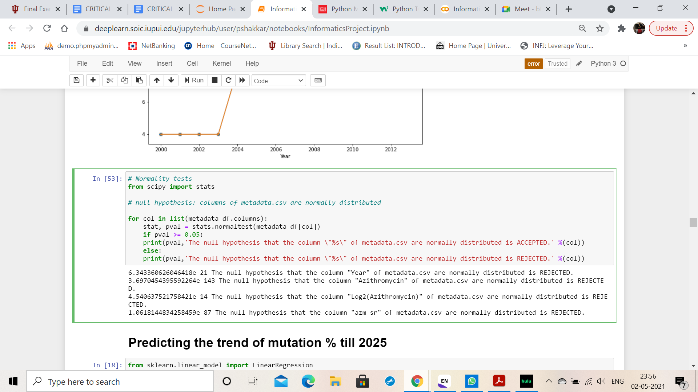
Normality test of the cleaned data

Slide 20
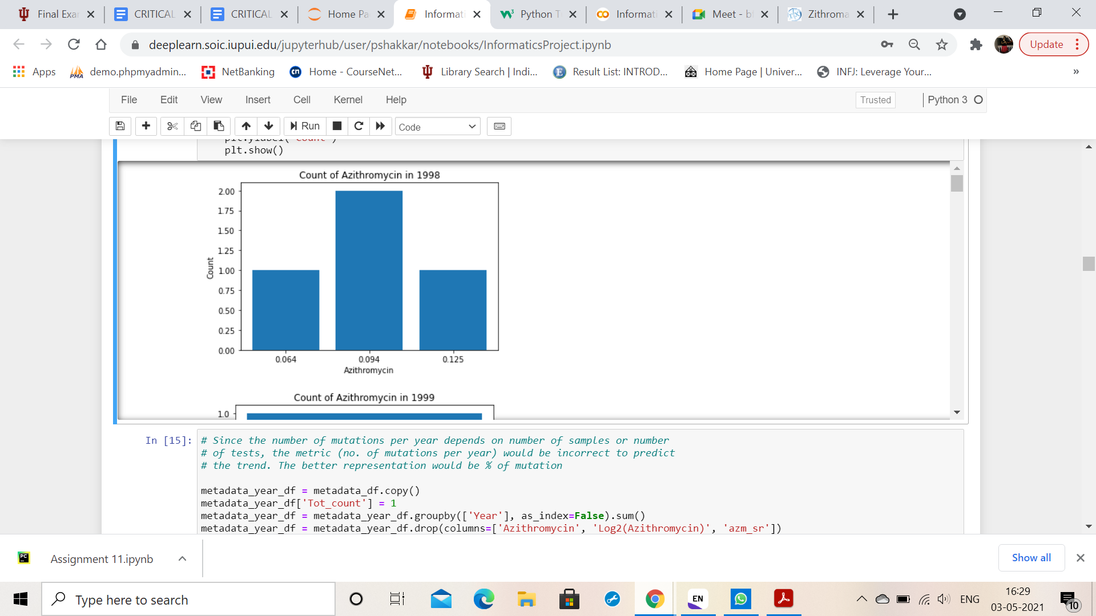
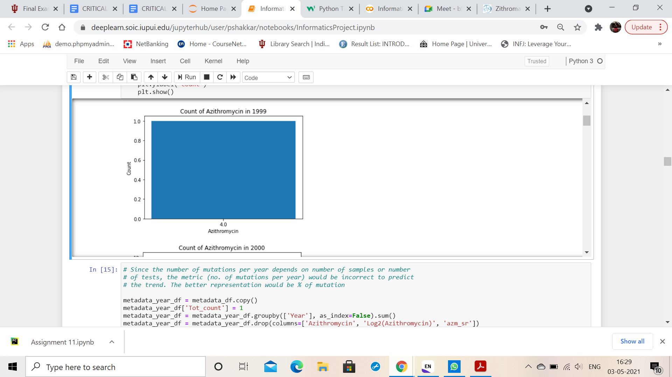
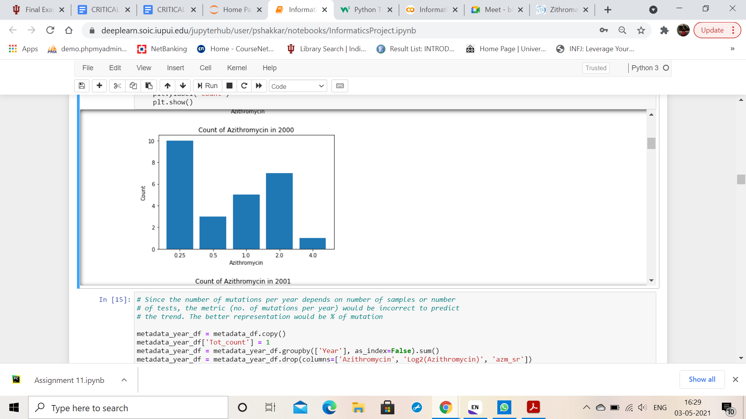
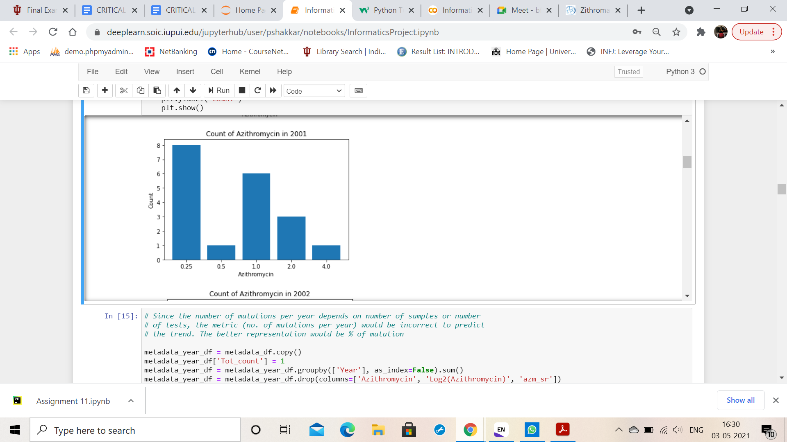
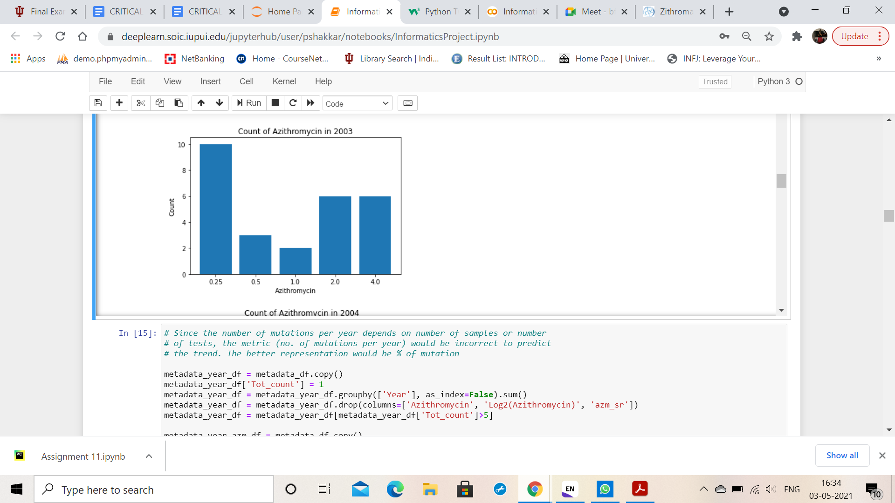
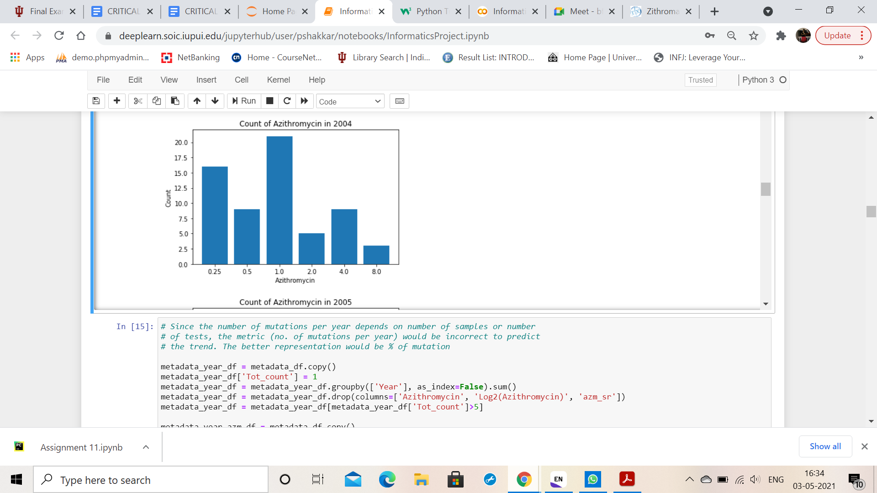
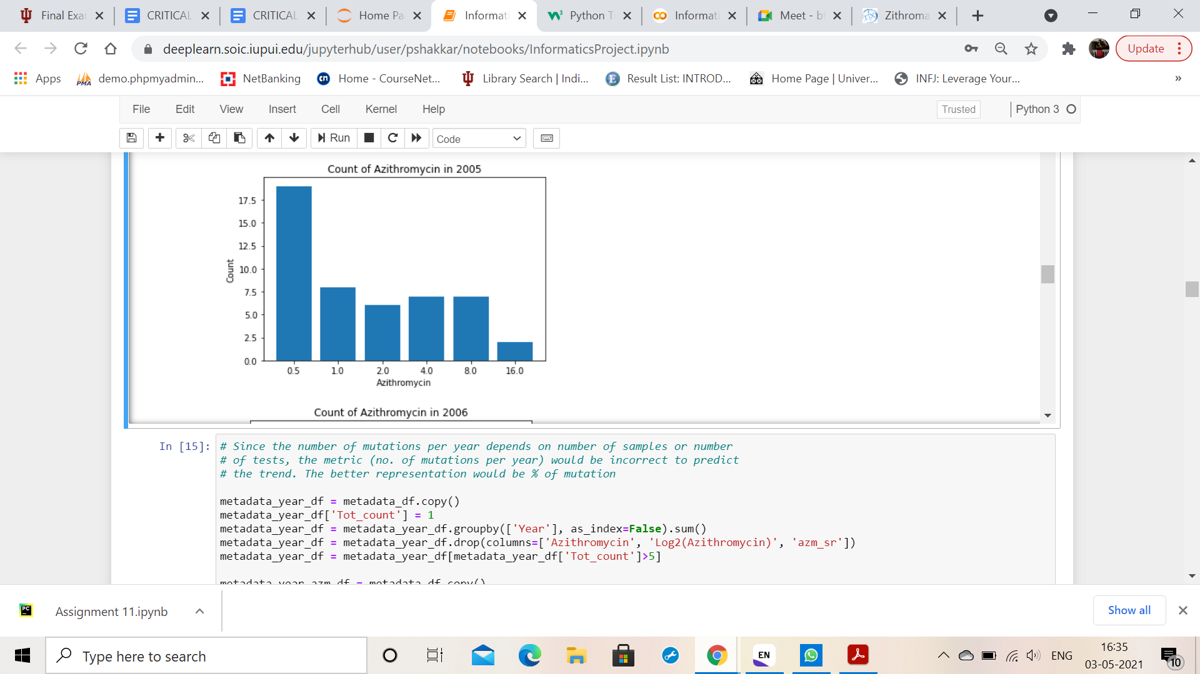
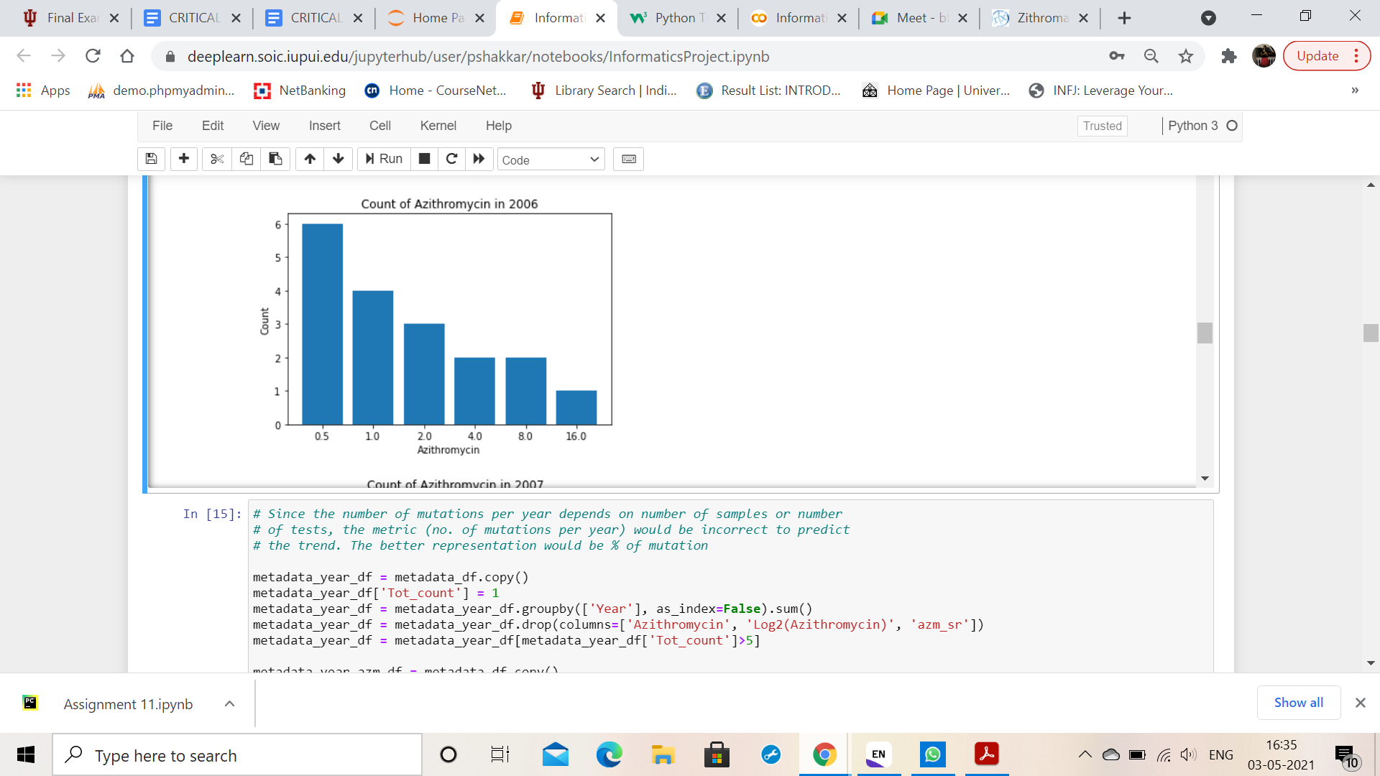
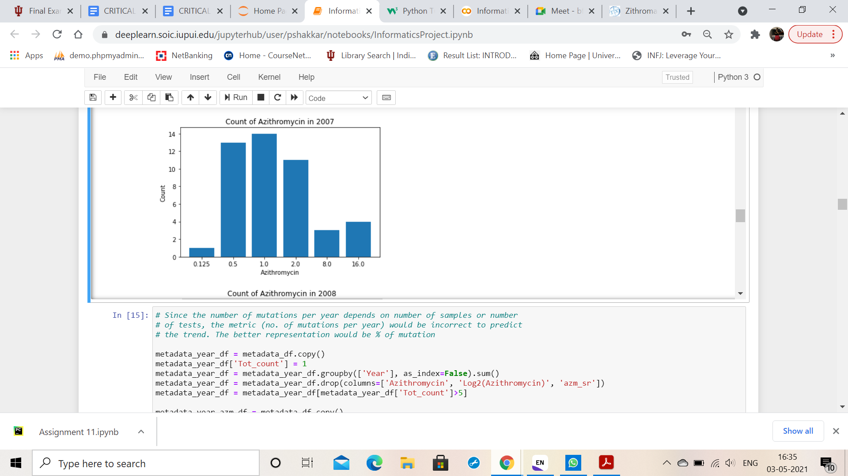
Count of samples per year per Azithromycin

Slide 21
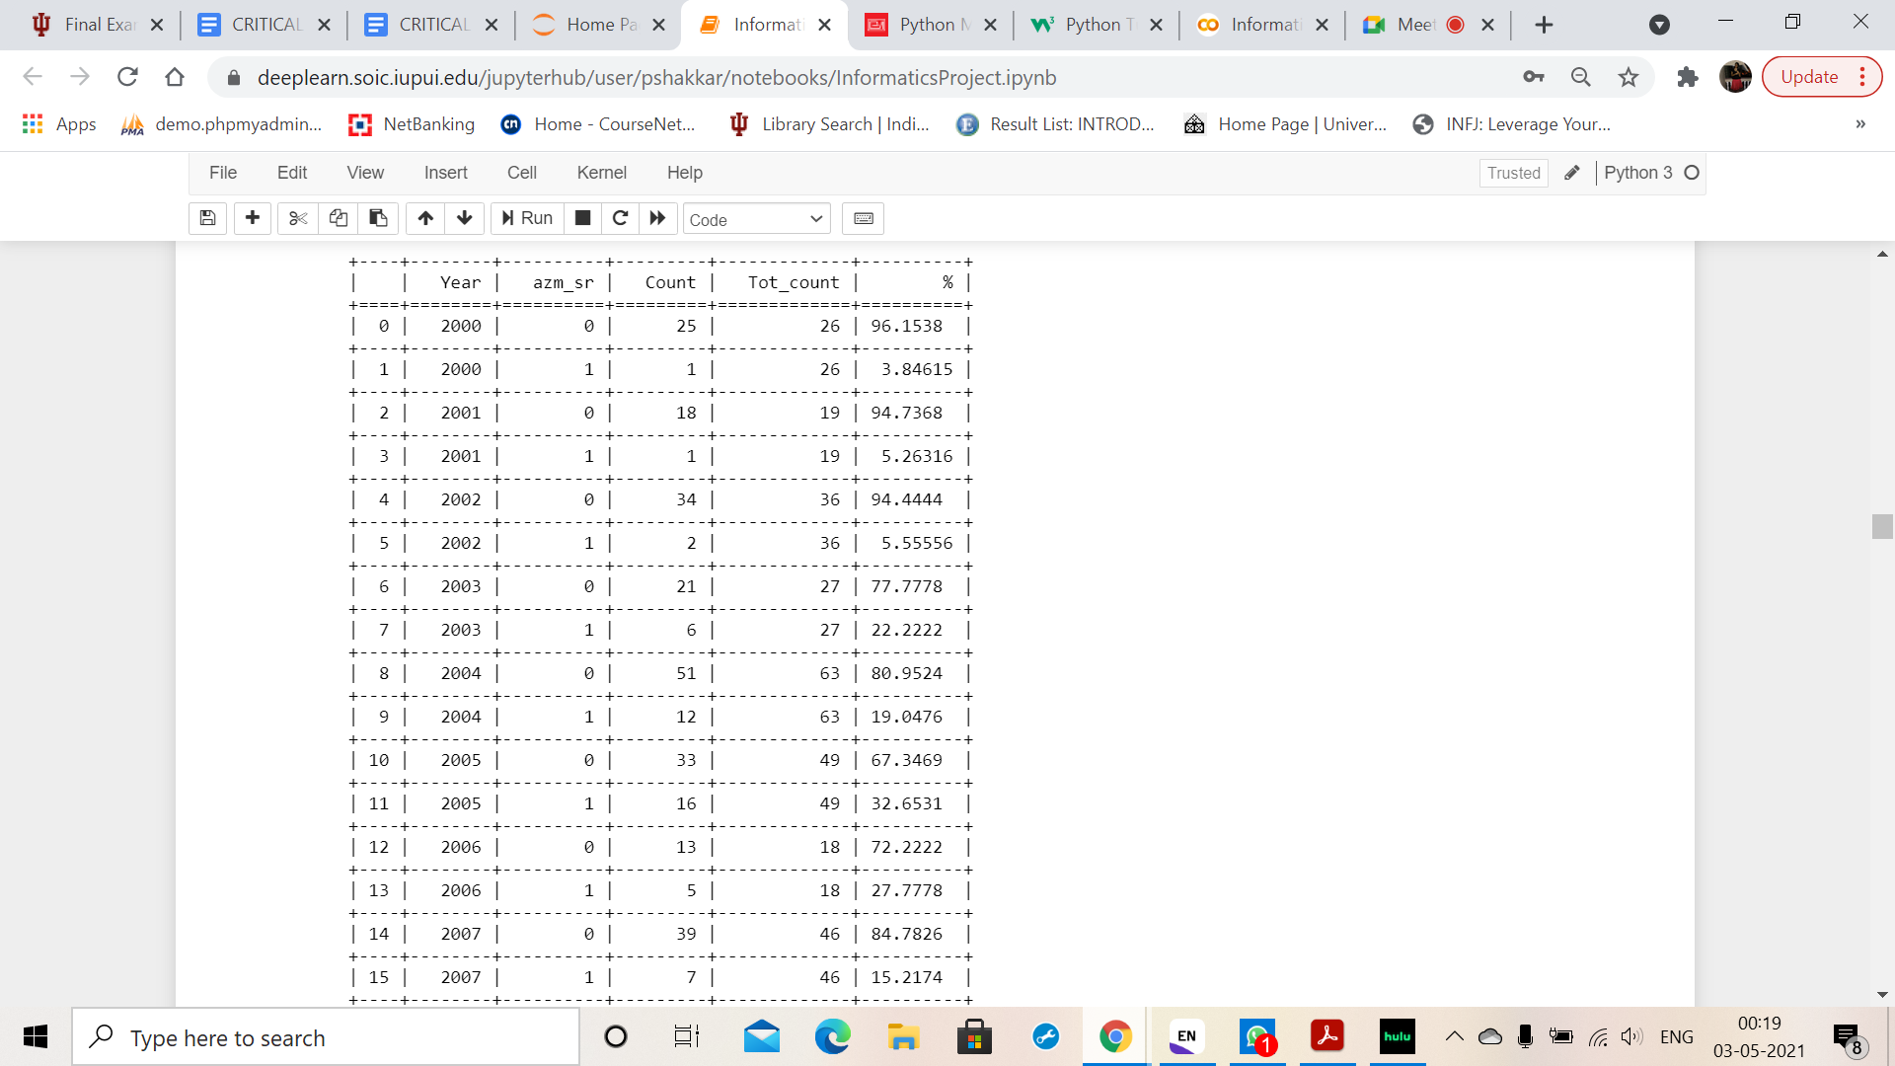
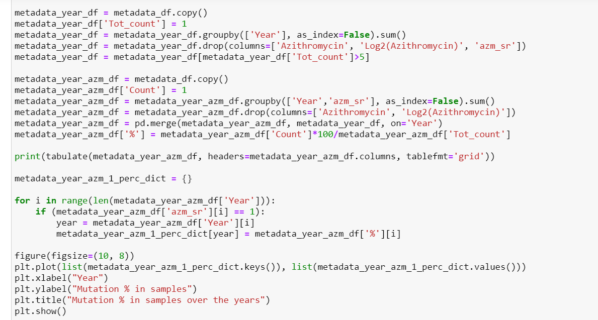
Percentage of mutations and non-mutations per year

Slide 22
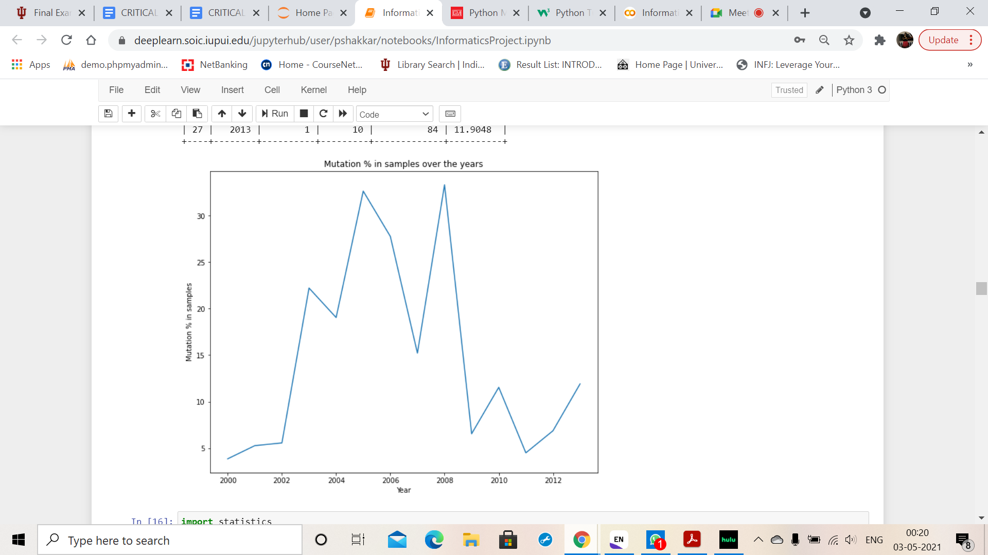

Slide 23
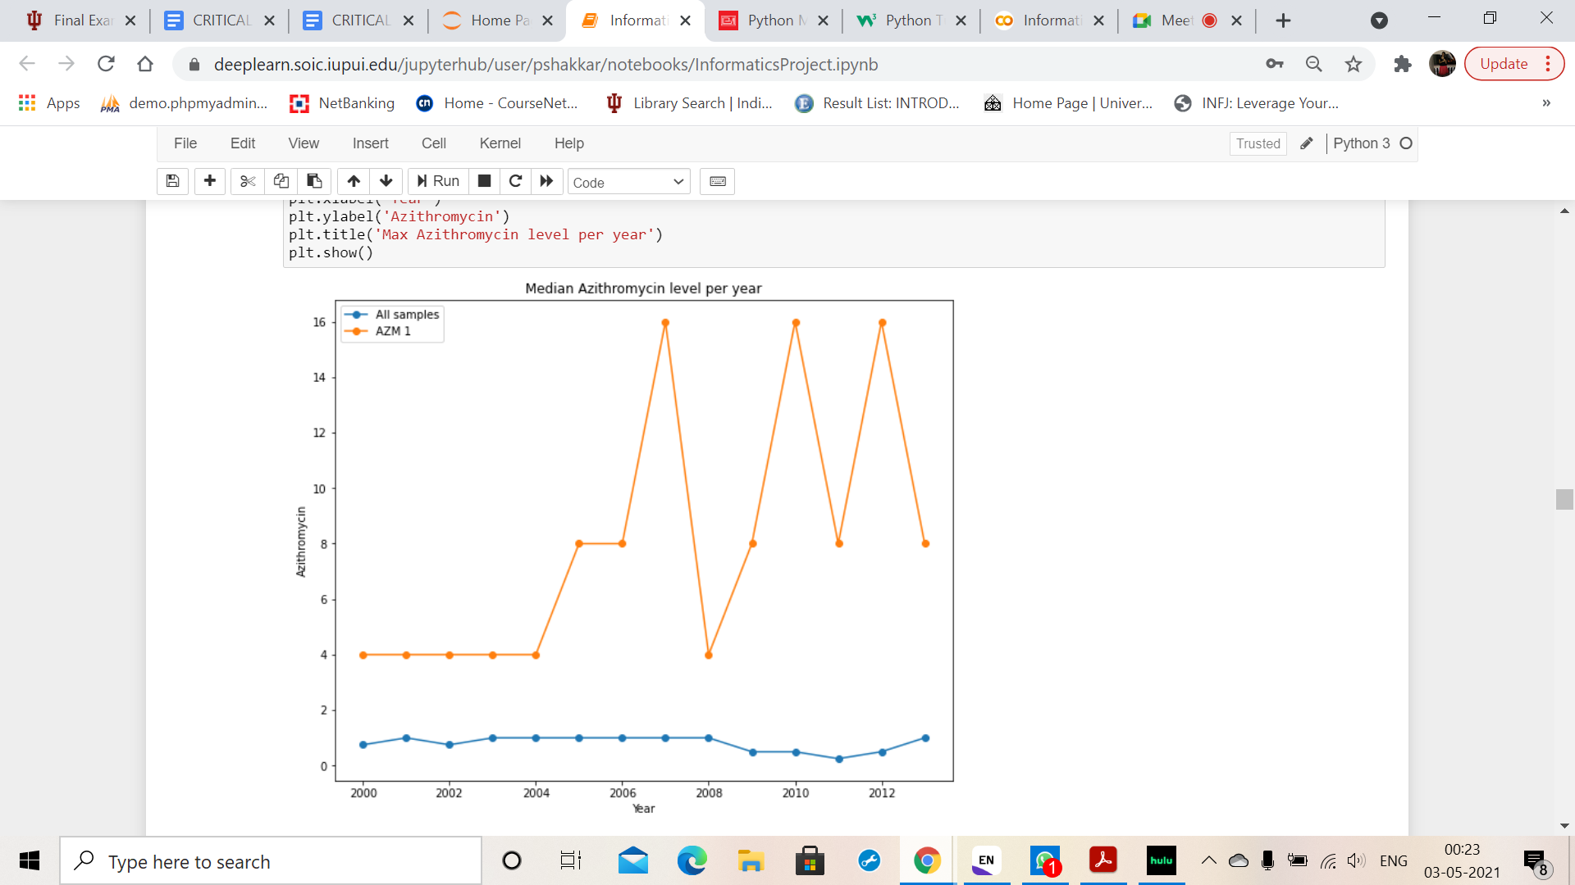
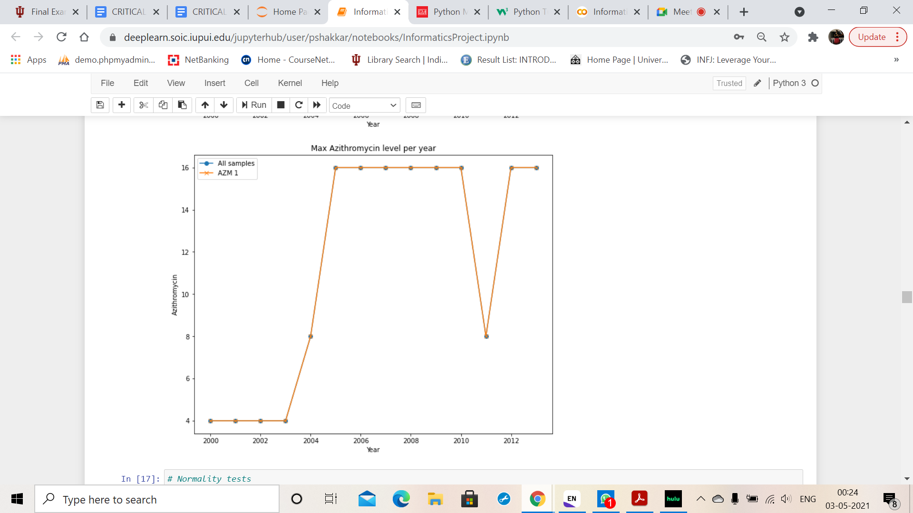

Slide 24
METHODOLOGY

Slide 25
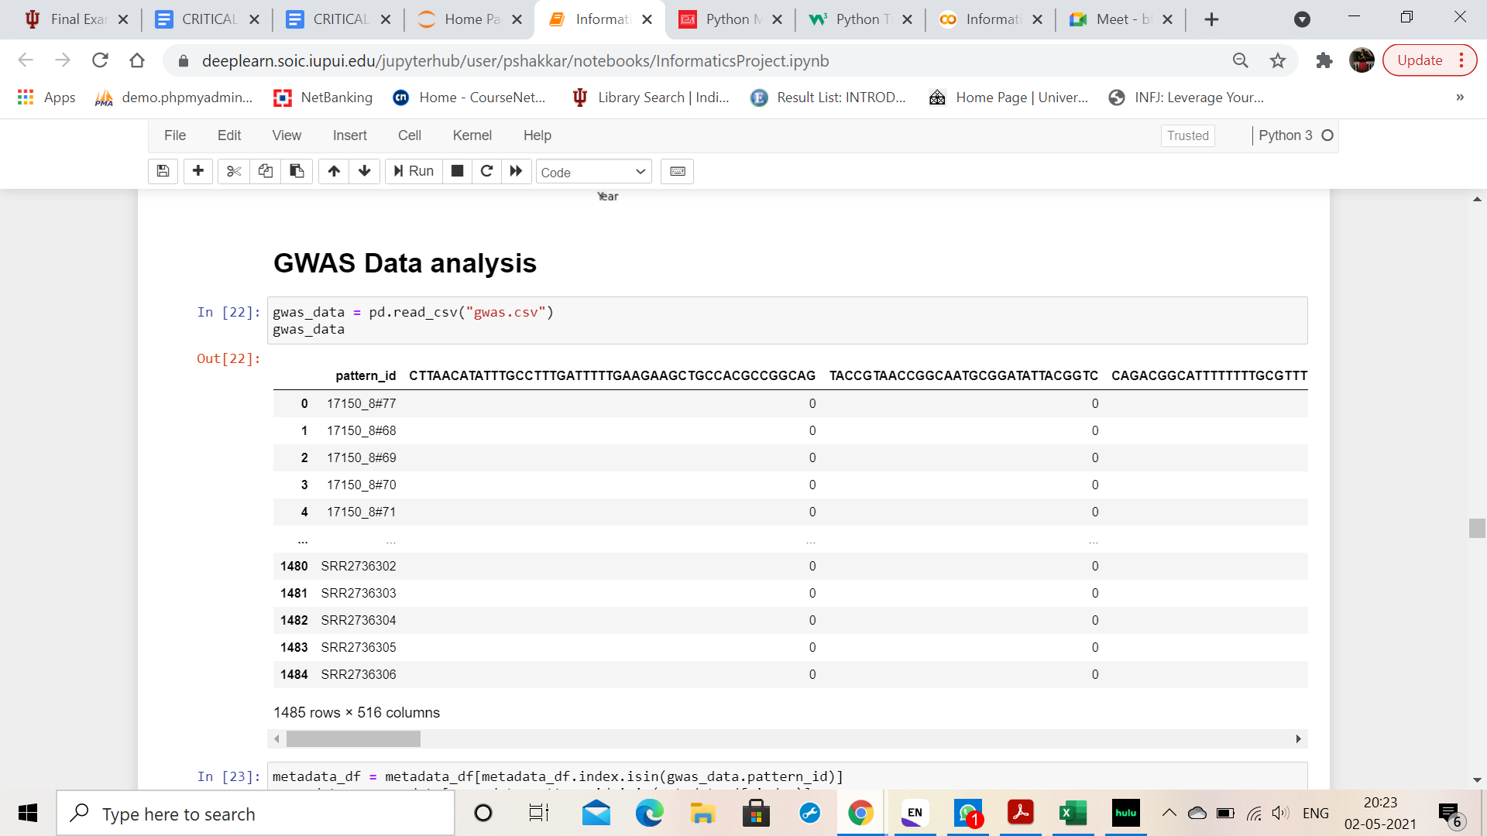
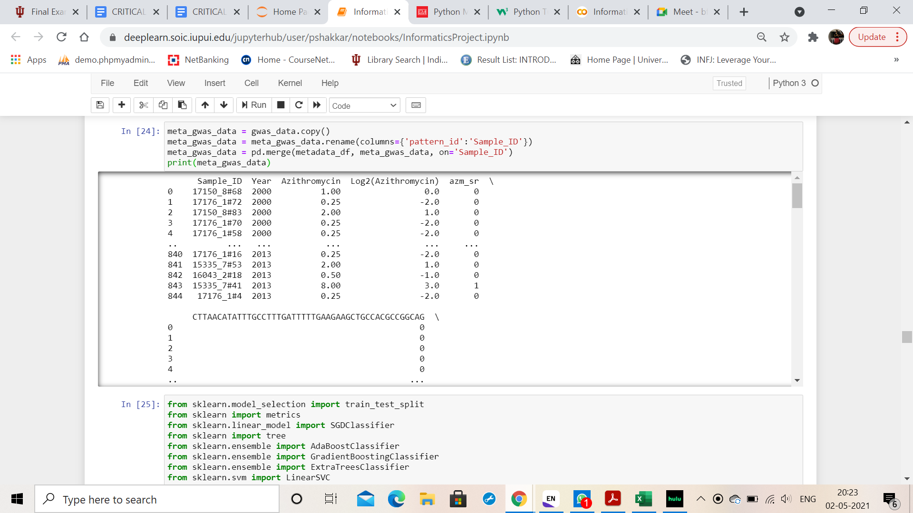
GWAS data description and merging of GWAS data with Metadata

Slide 26

Classification Models
SGDClassifier
LinearSVC
DT (Decision Tree) - Gini
DT (Decision Tree)- Entropy
AdaBoostClassifier
ExtraTreesClassifier - Gini
ExtraTreesClassifier - Entropy
GradientBoostingClassifier
RandomForestClassifier - Gini
RandomForestClassifier - Entropy
Linear Regression

Slide 27
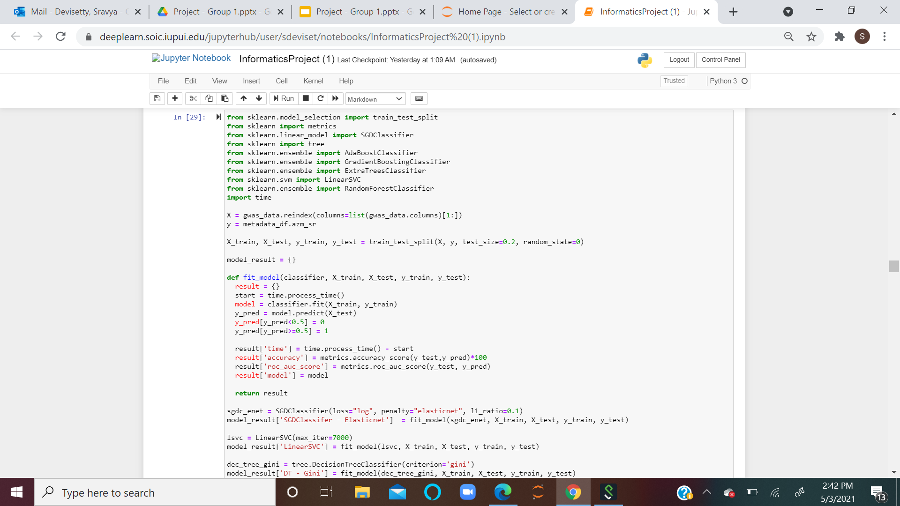
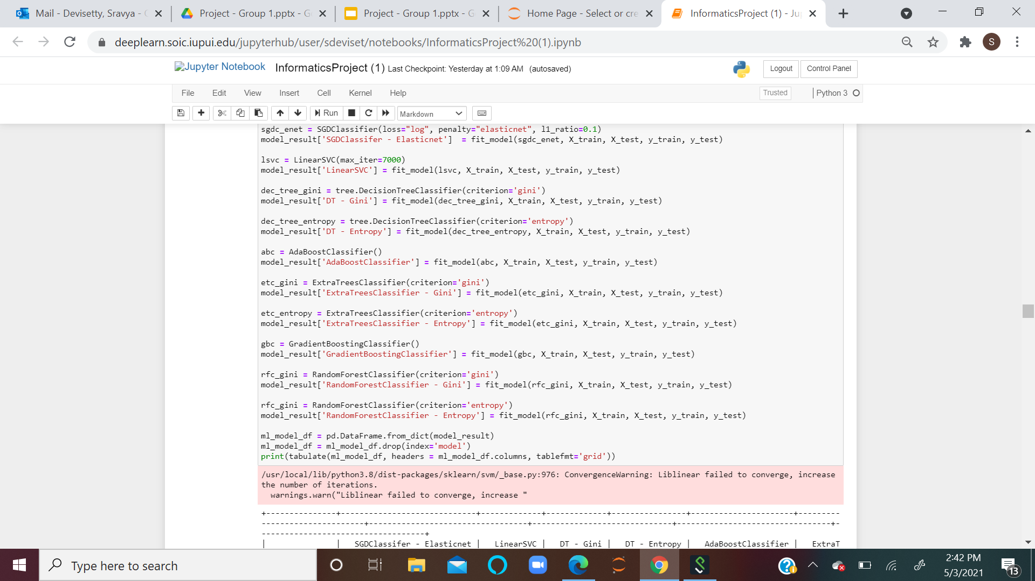
Building various Machine Learning Models and performance analysis

Slide 28
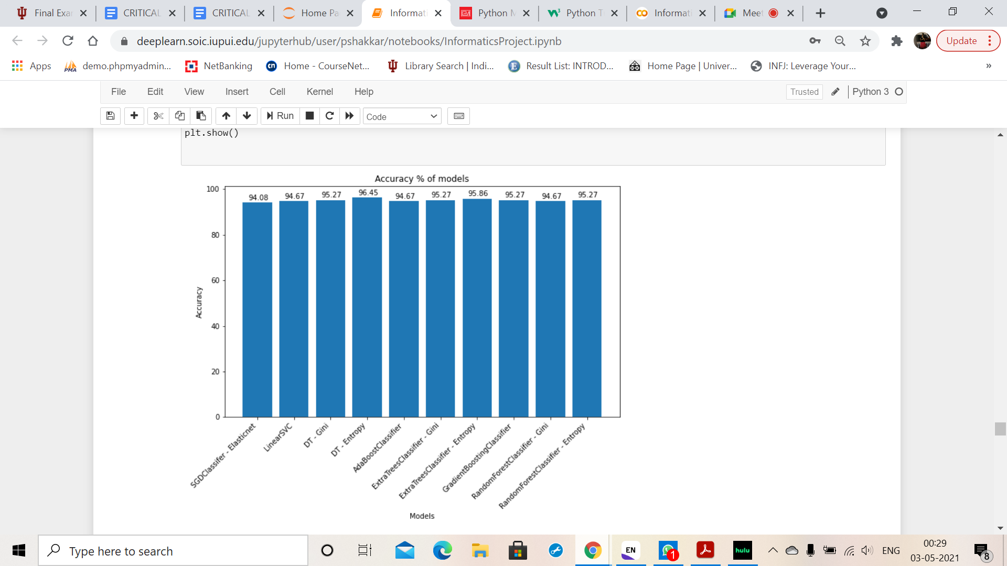
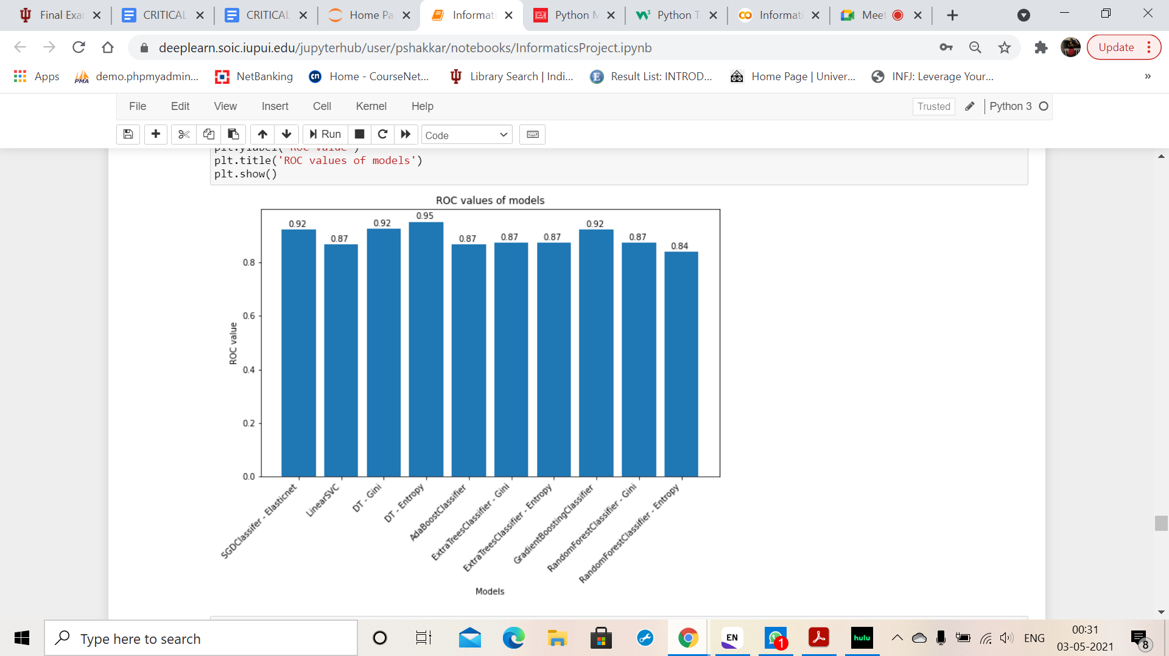
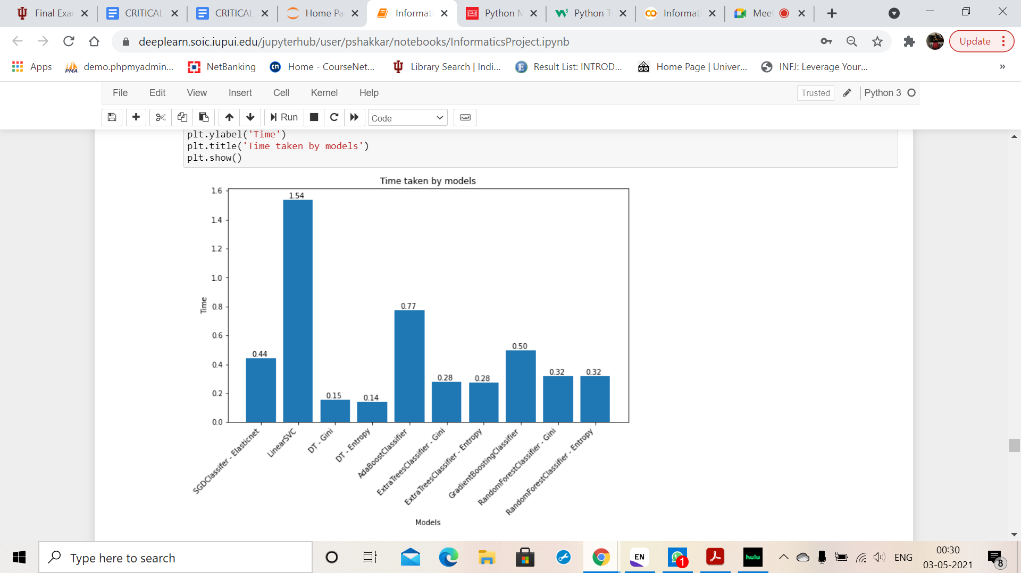
Building various Machine Learning Models and performance analysis

Slide 29
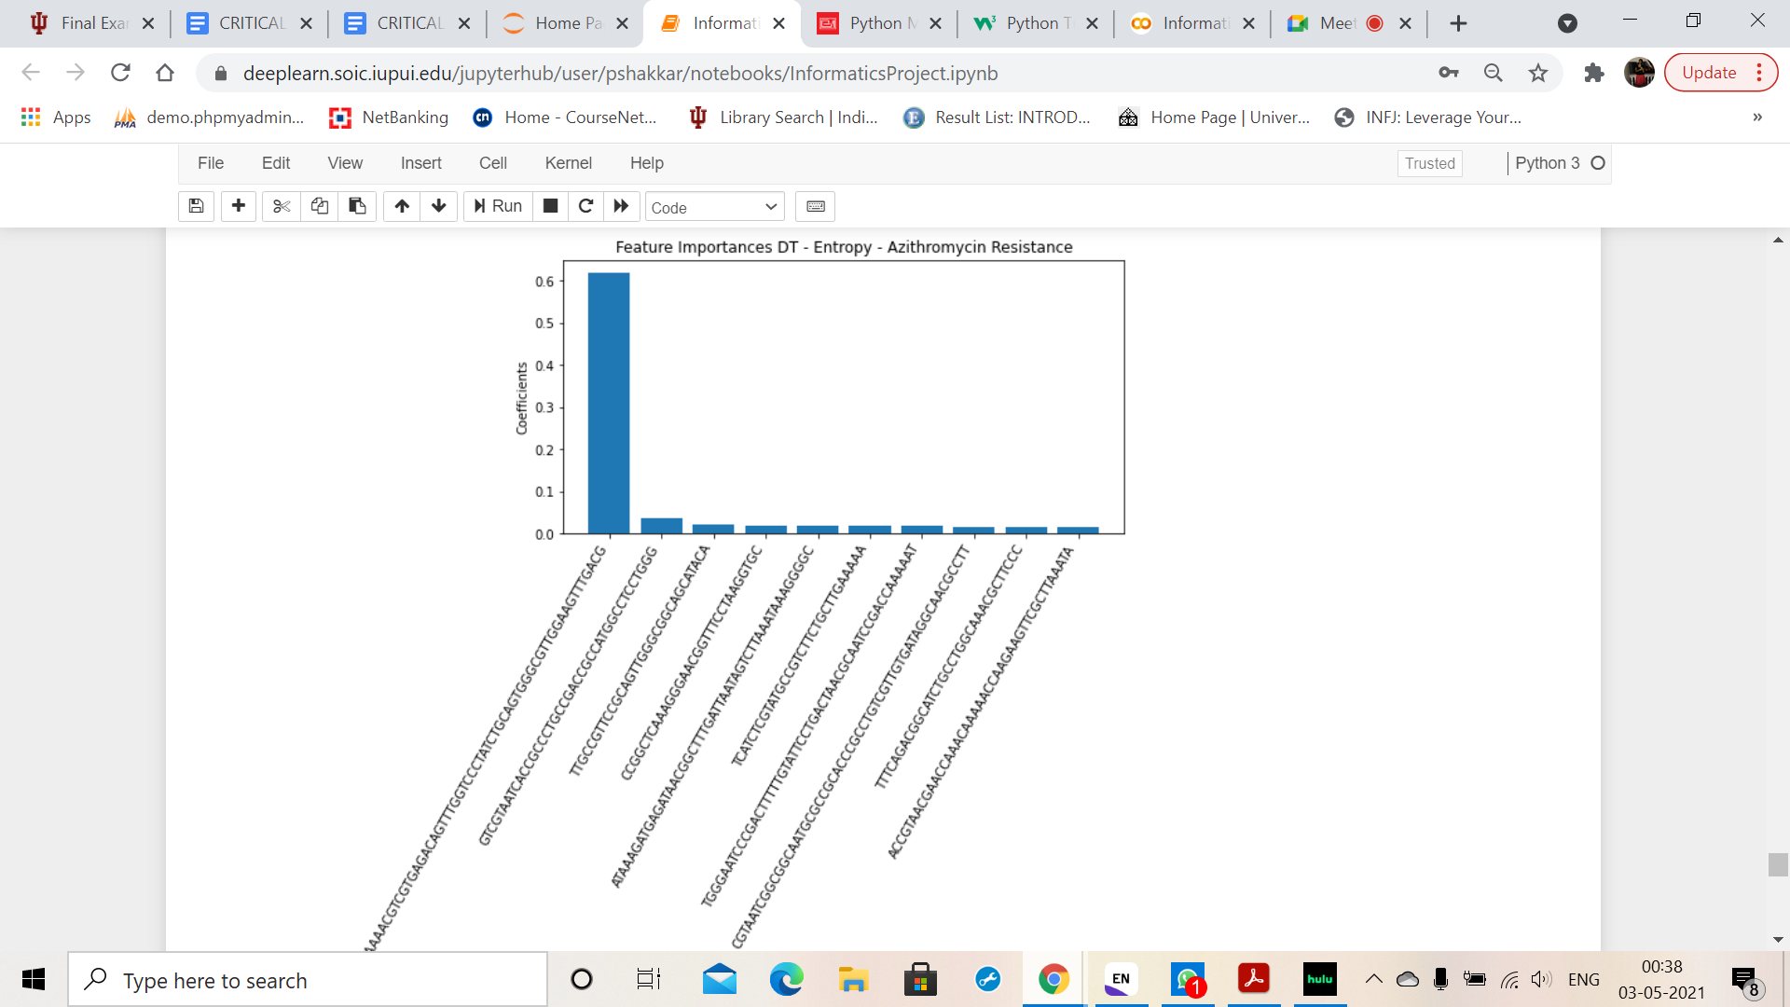
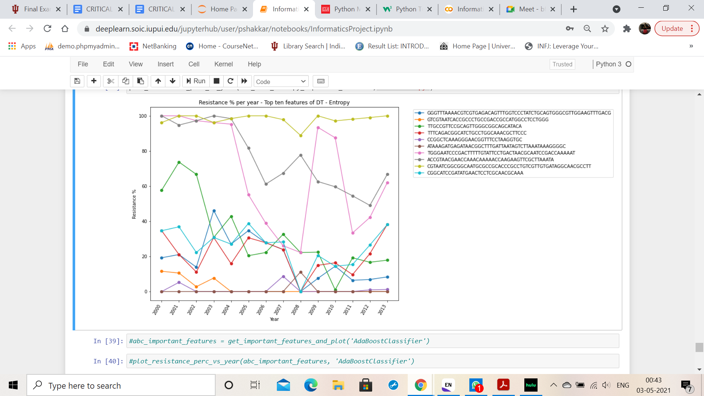
Feature importance of the best suited models for this data set

Slide 30
Bacterial DNA genetic codes
S.NO | Bacterial DNA | Gene Name
1. | CATCACCTTAGGGAATCGTTCCCTTTGGGCC | NGMG_00872
2. | TGGGAATCCCGACTTTTTGTATTCCTGACTAACGCAATCCGACCAAAAAT | NGMG_02304
3. | GTGTTACGCAATATATAAGGGGTTGCCGTTCC | N776_04030
4. | ACCGTAACGAACCAAACAAAAACCAAGAAGTTCGCTTAAATA | NEIPOLOT_01195
5. | CCGTTGCCGTTGCCGTCGCCGTCGCCGCTGCCG | BHV70_00400
6. | CTTGGATATGTCCAATCCTACAGTGTTACGCA | N776_04030
7. | AAGTCGGGAAATGCCCTTATCCGGTATGCGACCA | N776_04030
8. | GGAAGGCGTTCCCCGGAGCACCCAGGAGGCCATGGC | A2X74_05240
9. | ATGCGCGTCGCCTACGGACACGTCAGACACG | N776_05720
10. | GTTGAAAAAATCTTTAGCTACGTCAACGCGGGTAATTTTT | EGK74_13440

Slide 31
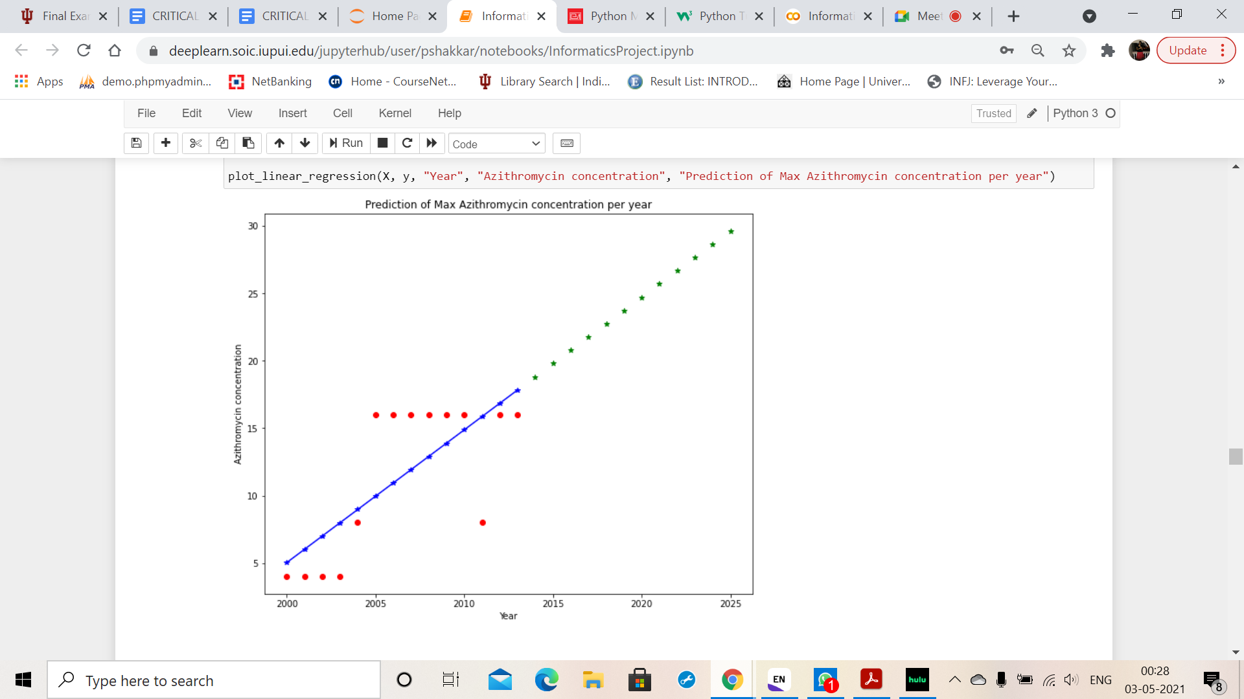

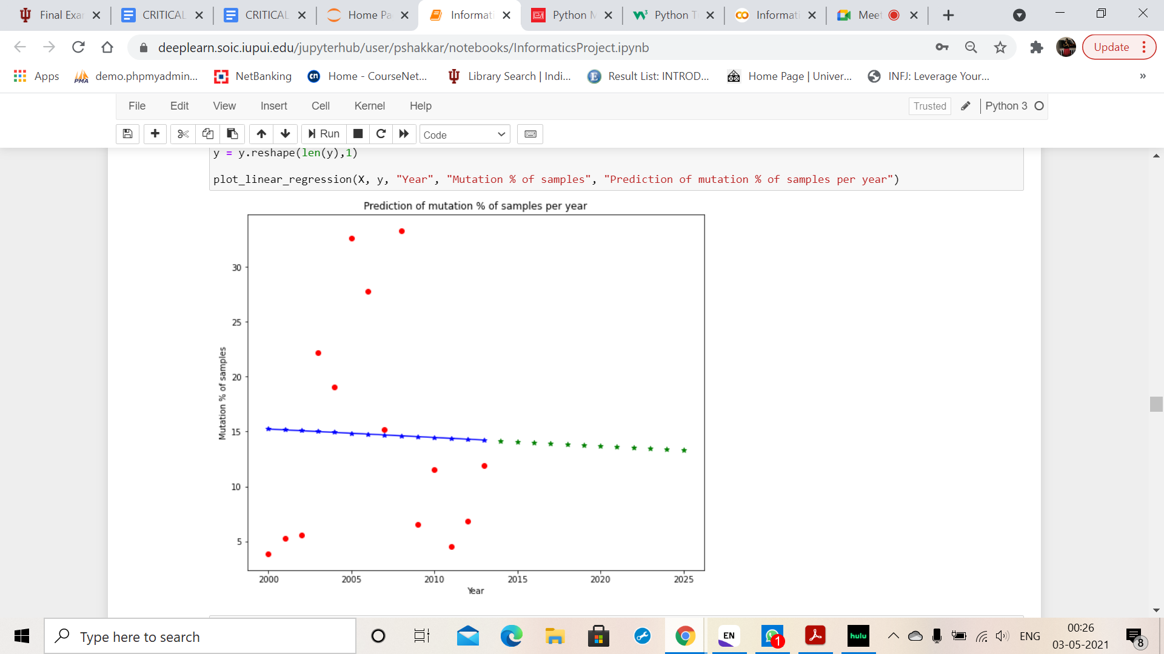
Predicting trend upto year 2025 through Linear Regression model
Trends of Azithromycin Concentration - based on Maximum and Median Values
Trends of mutation percentage

Slide 32
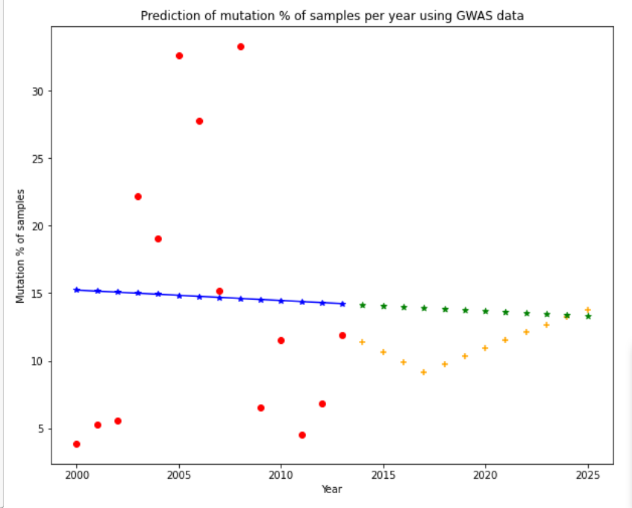
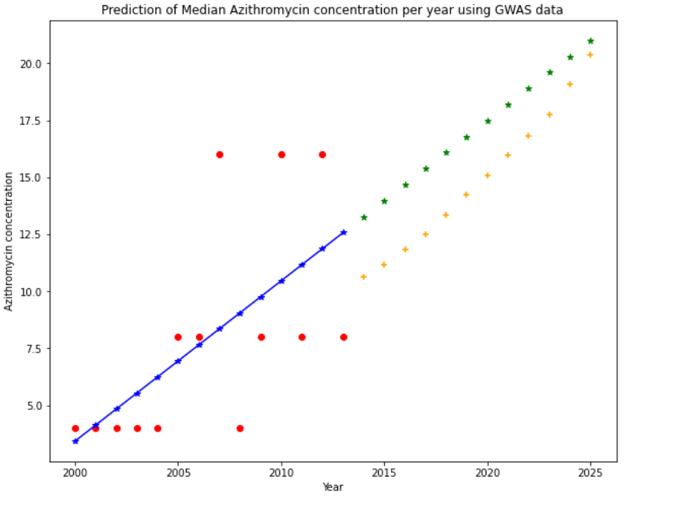
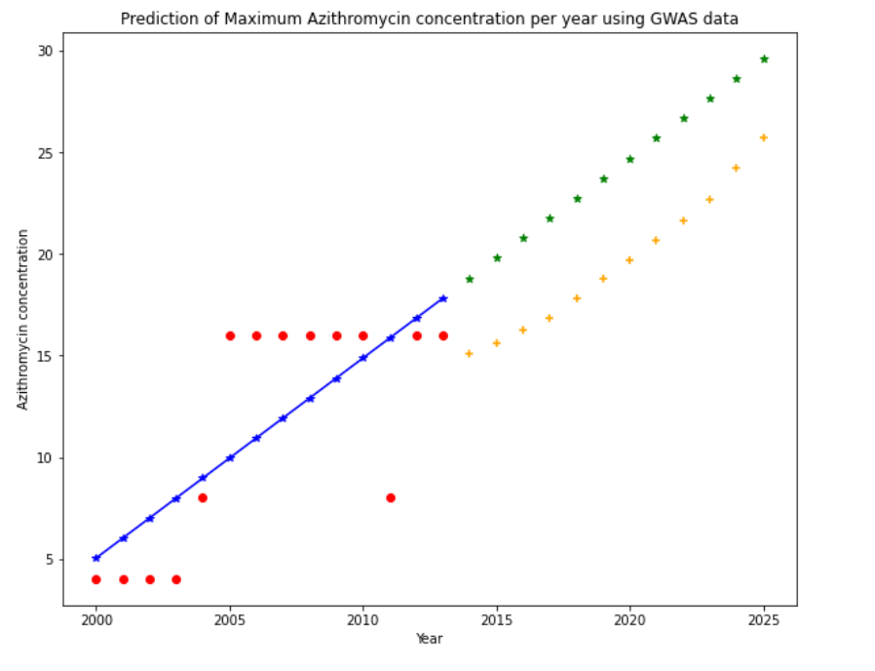

Slide 33
Statistical Testing
Mancova

Slide 34
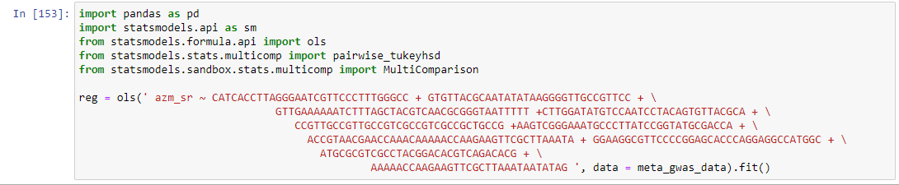
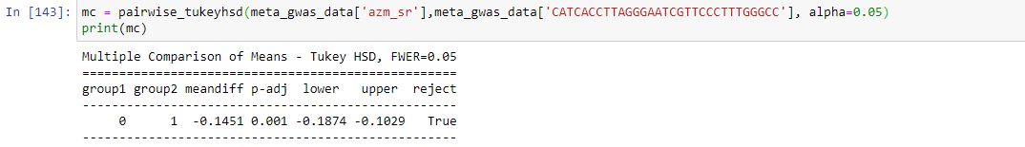
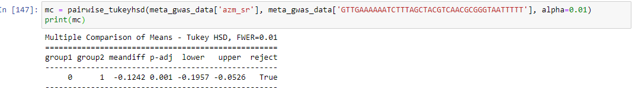
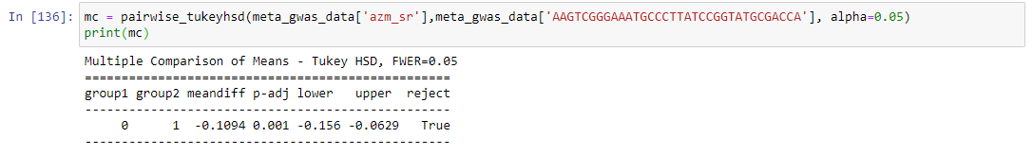
MANCOVA

Slide 35
MANCOVA Interpretation
There is a significant relationship between the factors tested and Azithromycin Resistance.

Slide 36
Result Summary
1. The NGMG_00872, EGK74_13440, N776_04030, A2X74_05240, BHV70_00400 genes displayed the high resistance to Azithromycin among all the gene sequences.
2. The Minimum inhibitory concentration of Azithromycin is increasing year by year till 2025.
3. The Azithromycin resistance is decreasing year by year till 2025.
4. The Null Hypothesis is rejected.
5. Since the mutations are decreasing and the azithromycin levels are increasing by the year 2025, we are predicting that the Azithromycin consumption will increase.

Slide 37
Appendix:
DATA:
https://drive.google.com/drive/folders/1TF7VQmWLOmaxYpVefVCZ19furp76sosB?usp=sharing
CODE (Jupyter notebook):
Informatics Project - Group 1.ipynb file

Slide 38
Acknowledgement
Professor: Dr. Saptarshi Purkayastha
Teaching Assistants: Snigdha Kodela
Akhil Joseph

